Slide 1


Generative AI and AIoT (GenAIoT) Coding Skills Education for Gifted Students (2024) Lesson 1.2: Introduction to Version Control and GitHub

Slide 2
Table of Contents
Introduction to Version Control
Introduction to Git
GitHub and GitHub Desktop
Installations and Account Registration
Git Exercises
Github Desktop
Github
Github Client and extensions

Slide 3
Introduction to Version Control

Slide 4

Naïve Version Control Method – Copy Files
You have written a Python program called program.py
program.py
4

Slide 5
Naïve Version Control Method – Copy Files
You want to develop new features for your program
But you want to keep the original file in case you make a mistake.
So, you copy and paste the original file and work on the copied file, renaming it as program_v2.py
program.py
program_v2.py
5

Slide 6
Naïve Version Control Method – Copy Files
You continue this process, so you have program_v3.py
program.py
program_v2.py
program_v3.py
6

Slide 7
Naïve Version Control Method – Copy Files
As time goes by, you have _v4, _v5, _v6, etc.
program_v2.py
program_v3.py
program.py
program_v4.py
program_v6.py
program_v5.py
7

Slide 8


Naïve Version Control Method – Copy Files
Your colleague Alice collaborates with you, so you have program_bob_v1/2/3/4/5/6.py and program_Alice.py
Bob’s code
program_v2_bob.py
program_v3_bob.py
program_bob.py
Alice’s code
program_v4_bob.py
program_Alice.py
program_v6_bob.py
program_v5_bob.py
8

Slide 9
Naïve Version Control Method – Copy Files
Advantage:
Simple
Disadvantages:
Prone to error
May accidentally write to the wrong file
Hard to organize and collaborate
9

Slide 10
Table of Contents
Introduction to Version Control
Introduction to Git
GitHub and GitHub Desktop
Installations and Account Registration
Git Exercises
Github Desktop
Github
Github Client and extensions

Slide 11


Published Git Version Control in 2005
Linus Torvalds
11

Slide 12
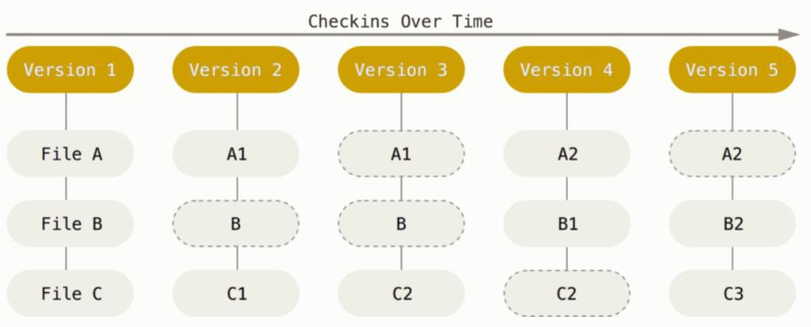
Introduction to Git
Git is a Version Control System (VCS)
Git takes a snapshot of what all your files look like a particular version
And stores a reference to that snapshot
https://git-scm.com/book/en/v2/Getting-Started-What-is-Git%3F
12

Slide 13
Introduction to Git
The advantages of using Git includes:
Able to revert the entire project back to a previous state
If you screw things up, you can easily recover
Compare changes over time
See who last modified something that might be causing a problem
See who introduced an issue and when
13

Slide 14
The Three States
Git has three main states that your files can reside in:
Modified: You have made changes to the file but have not committed it to your database yet.
Staged: You have marked a modified file in its current version (to checkpoint a file) and prepared it for a commit.
Committed: The data is safely stored in your local database.
14

Slide 15
The Three Sections of a Git Project
The 3 sections of a Git project:
Working tree: The directory and all its subdirectories which are under version control, it’s the place where you modify the files.
Staging area: A file that stores information about what will go into your next
commit.
.git directory (repository or repo): A place where Git stores the metadata and
object database for your project (i.e. the snapshots of your project). If a particular version of a file is in the object database, it’s considered committed.
15

Slide 16
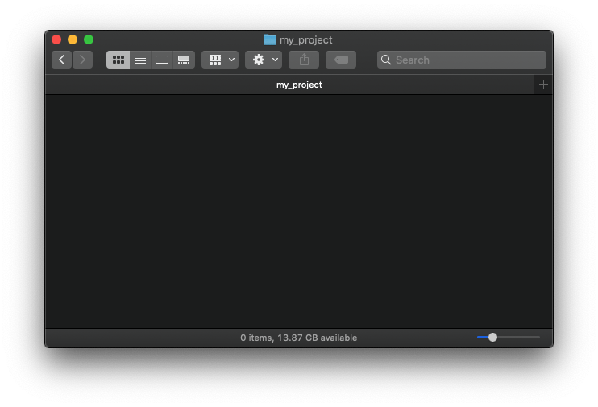

Basic Git workflow
Staging area
You modify files in your working tree
program.py
16

Slide 17
Basic Git workflow
Staging area
git add
program.py
program.py
2. You selectively stage just those changes you want to be part of your next commit, which adds only those changes to the staging area.
17

Slide 18
Basic Git workflow
Staging area
Git directory
git add
program.py
program.py
git commit
3. You do a commit, which takes the files as they are in the staging area and stores that snapshot permanently to your Git directory.
If a particular version of a file is in the Git directory, it’s considered committed. If it has been modified and was added to the staging area, it is staged. And if it was changed since it was checked out but has not been staged, it is modified.
18

Slide 19
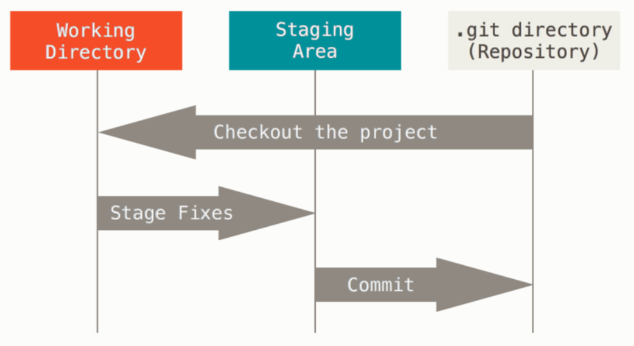
Basic Git workflow
modified
https://git-scm.com/book/en/v2/Getting-Started-What-is-Git%3F
19

Slide 20
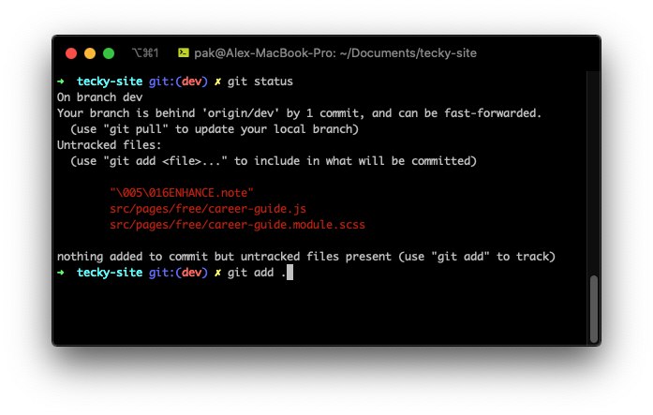


How to use Git ?it?
Command Line
GUI Clients
GitHub Desktop
SourceTree
Git Extensions
TortoiseGit
Magit
https://git-scm.com/
https://git-scm.com/downloads/guis
20

Slide 21
Table of Contents
Introduction to Version Control
Introduction to Git
GitHub and GitHub Desktop
Installations and Account Registration
Git Exercises
Github Desktop
Github
Github Client and extensions
21

Slide 22

The largest code hosting platform
for version control and collaboration
Git-based
22

Slide 23
Bob’s code
program.py
program_v2.py
Alice’s code
program_v3.py
program.py
program_v4.py
program_v6.py
program_v5.py
23

Slide 24
Collaboration
git clone
git pull
git push
git push
program.py
init.py
program.py
init.py
Github keeps your repositories Online (free cloud storage)
Facilitates better collaboration and code sharing
One of the best ways of software distribution
Personal portfolio (all your codes in one place and safe)
24
https://github.com/

Slide 25



git
vs
vs
25

Slide 26
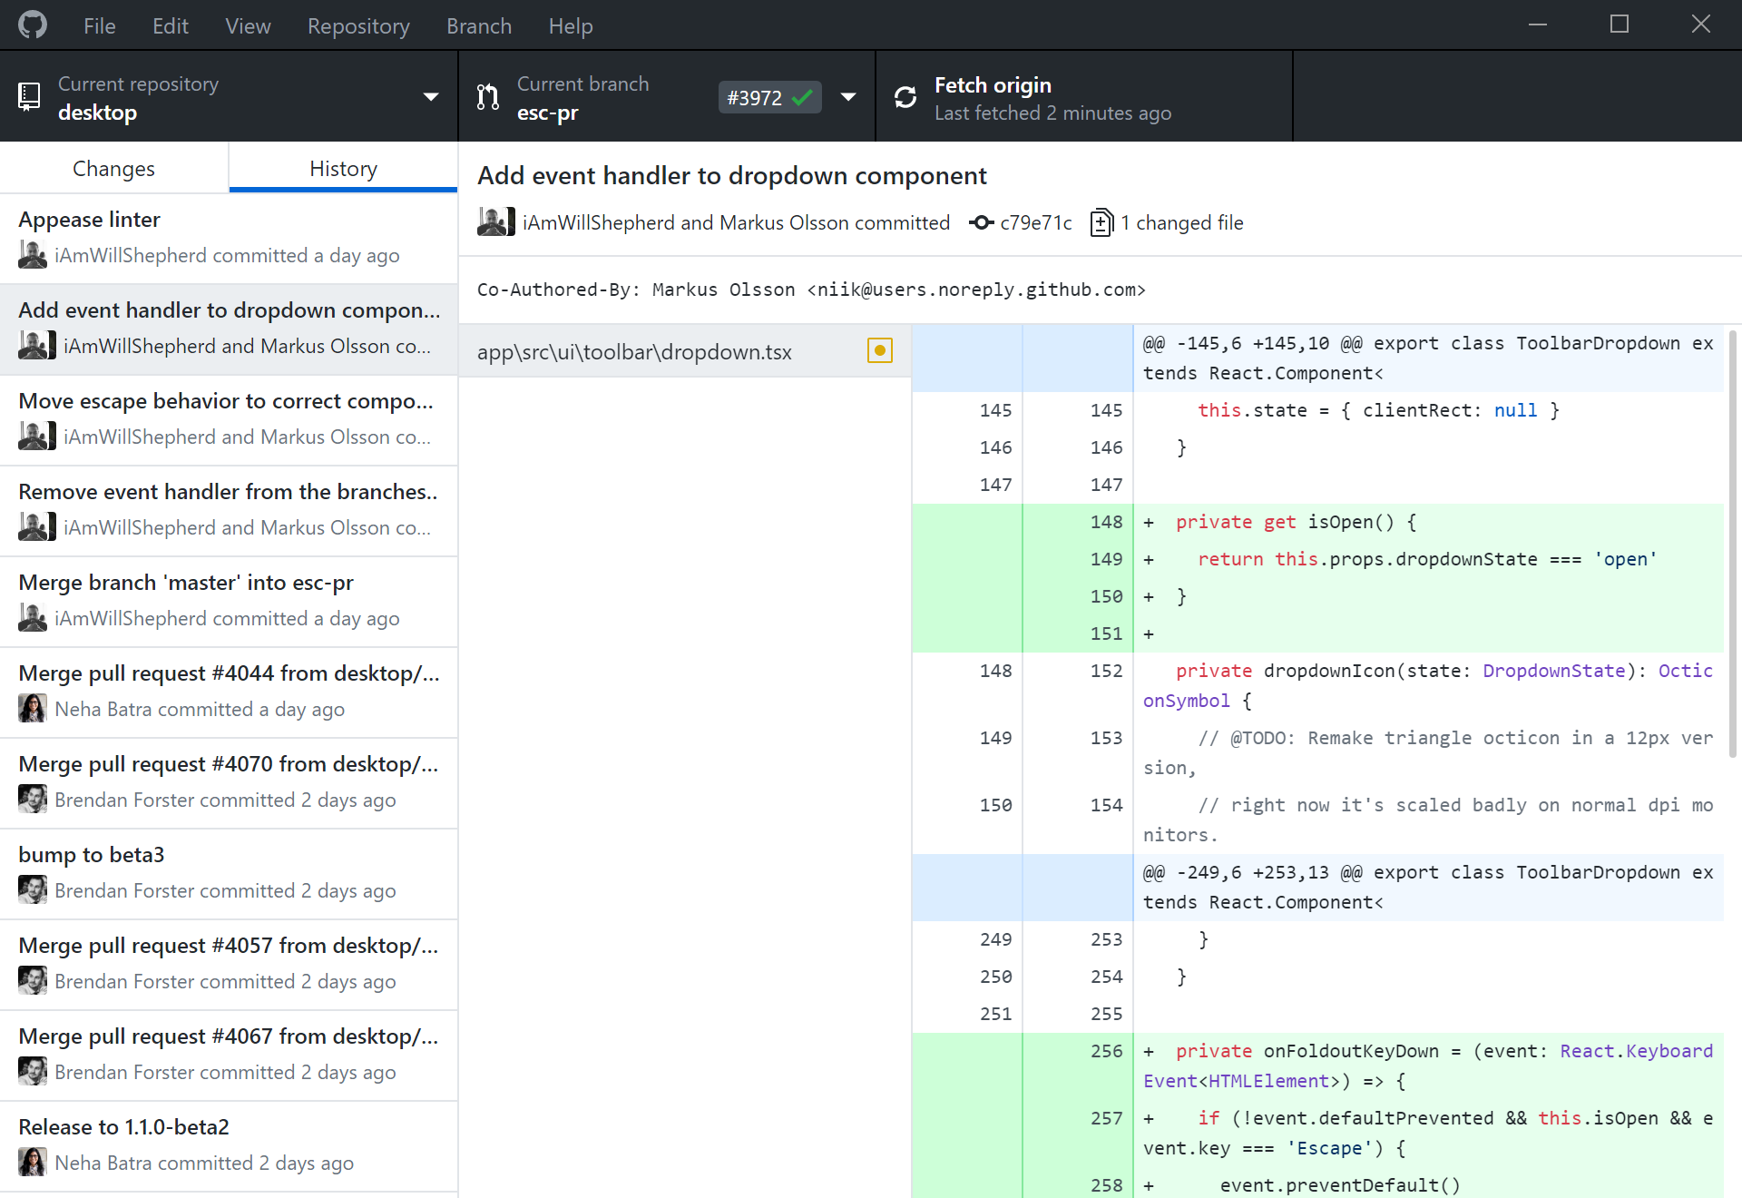

GitHub Desktop
GitHub Desktop: GUI tool to organize your repos locally
and to interact your local repos with GitHub
26

Slide 27
Table of Contents
Introduction to Version Control
Introduction to Git
GitHub and GitHub Desktop
Installations and Account Registration
Exercises
Github Desktop
Github
Github Client and extensions
27

Slide 28
Install Git Command Line on Your PC
To use Git on the command line, you'll need to download, install, and configure Git on your computer:
Windows:
Download Git installer and install it:
https://git-scm.com/downloads
Mac:
Install homebrew:
$ /bin/bash -c "$(curl -fsSL https://raw.githubusercontent.com/Homebrew/install/HEAD/install.sh)"
From homebrew:
$ brew install git
Linux:
Apt-get (Debian/Ubuntu):
# sudo apt-get install git
Other Linux distributions please refer to https://git-scm.com/download/linux
Installation guide: https://git-scm.com/book/en/v2/Getting-Started-Installing-Git
28

Slide 29

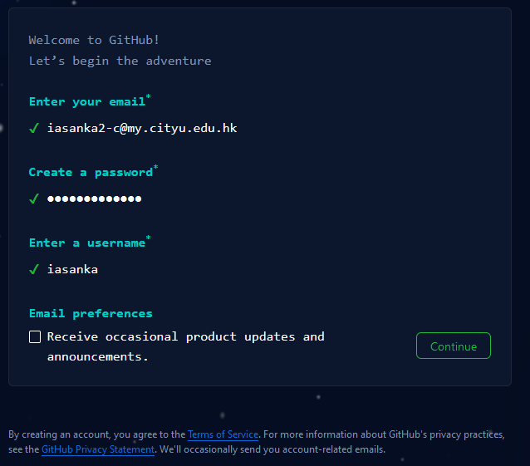
GitHub Registration
Sign up for a free GitHub account: https://github.com/
Steps:
Click “SignUp” and enter your details
Click Continue
Verify your account by solving a puzzle
Enter the code sent to your email
Done !!!
Sign in with your details
29

Slide 30
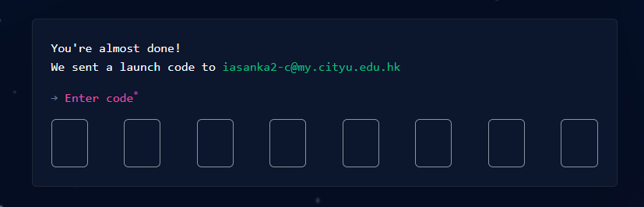
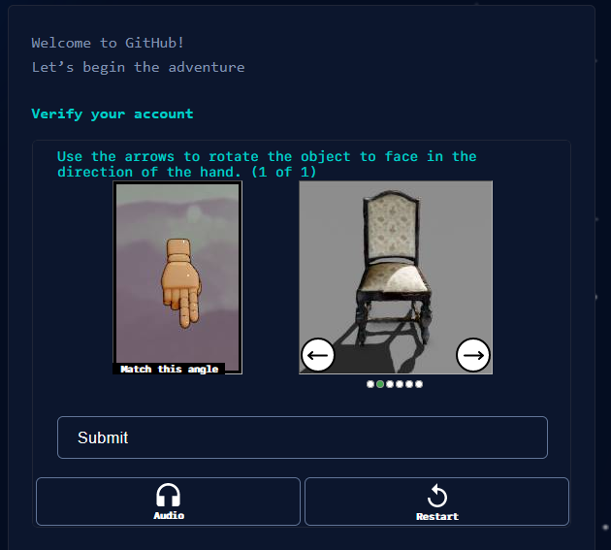
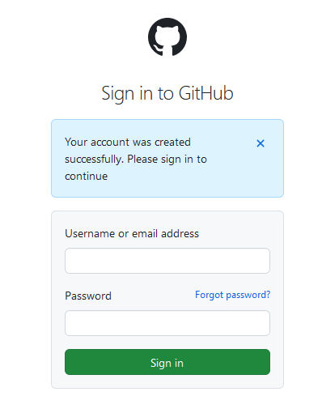
GitHub Registration
30

Slide 31
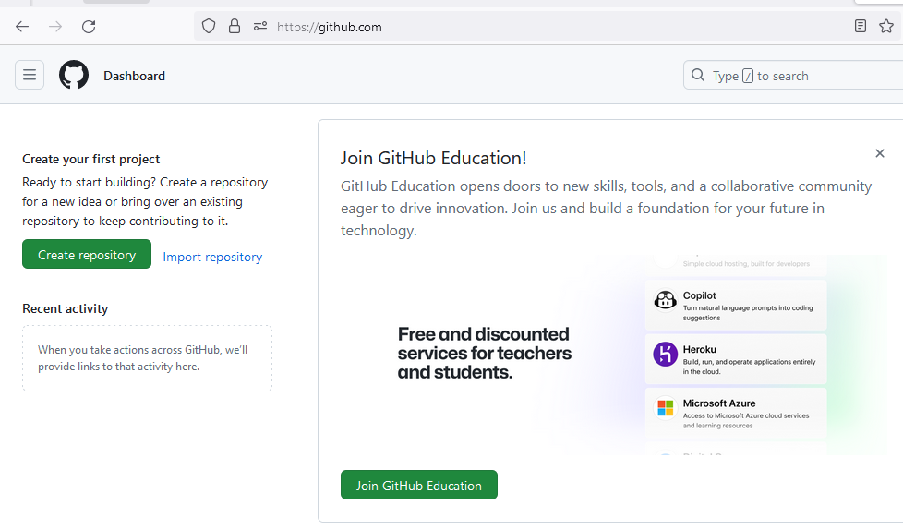
Your GitHub Account
31

Slide 32
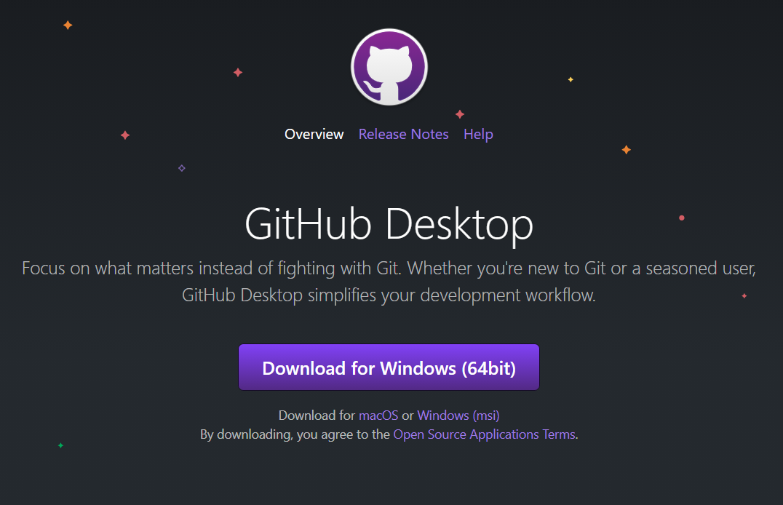
Install GitHub Desktop
GitHub Desktop is an application that enables you to interact with GitHub using a GUI instead of the command line or a web browser
Download and install GitHub Desktop: https://desktop.github.com/
32

Slide 33
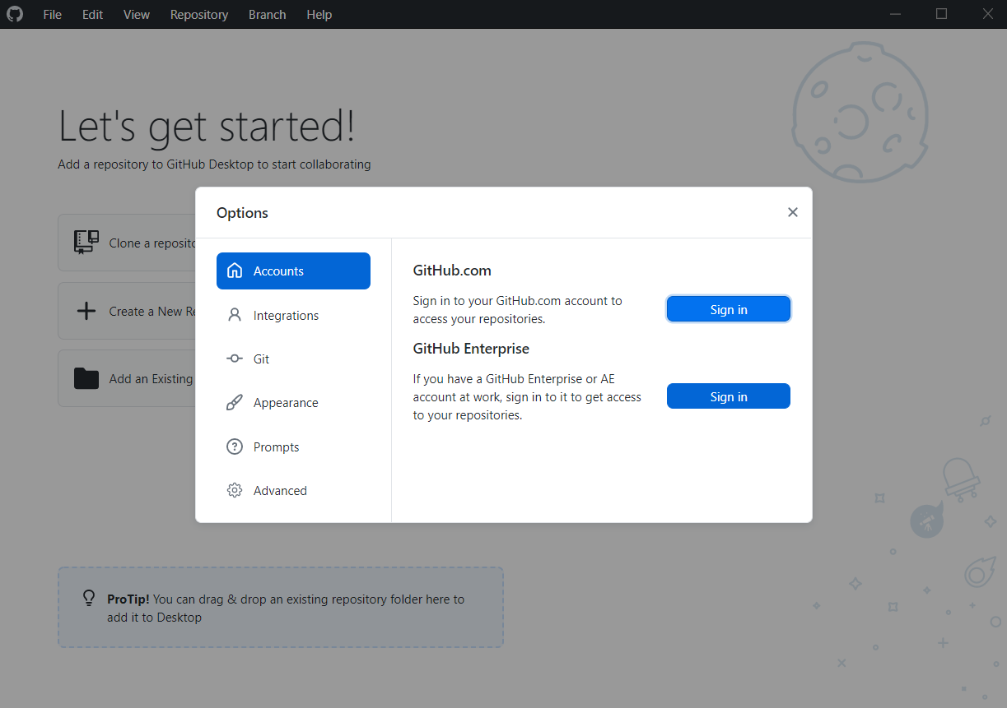
GitHub Desktop: Sign in
Sign in your GitHub account in GitHub Desktop:
File > Options... > Accounts > Sign in
33

Slide 34
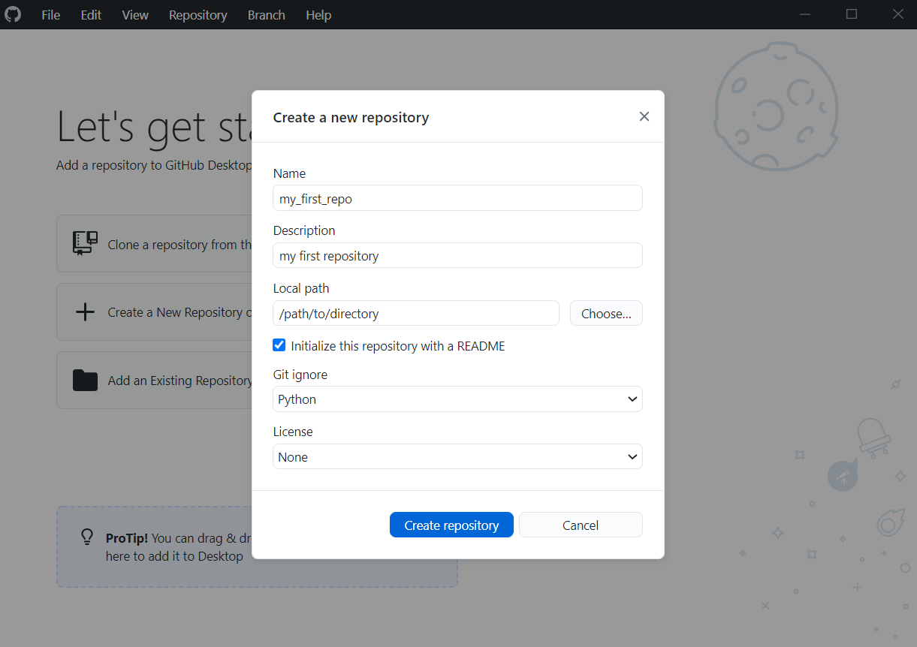
GitHub Desktop: Create a new local repo
Click “Create a New Repository on your hard drive…”
Fill in the Name and Description for your repository, i.e. ”my_first_repo”
Choose a path where you want to store the repo locally
Check the box “Initialize this repository with a README”
Choose “Python” for Git ignore
Choose “None” for License
Click “Create repository”
34

Slide 35
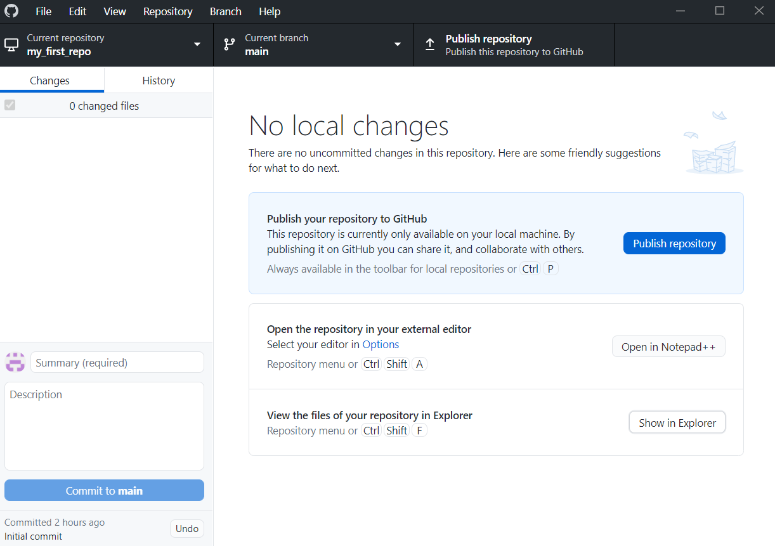
GitHub Desktop: Your new local repo !!!
Your “Current repository” should now be the repo you created just now
Click “Show in Explorer”
35

Slide 36
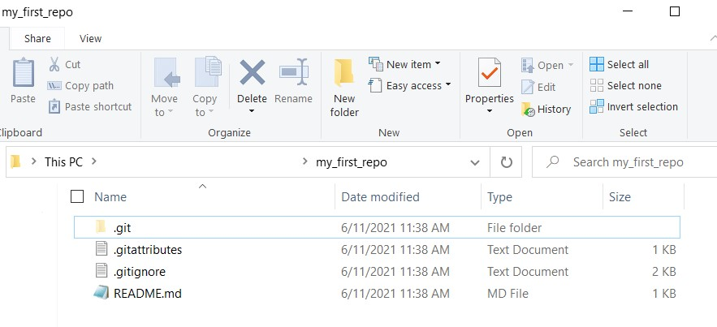
GitHub Desktop
Your repo should be found in the path you specified
You should find some files inside your repo, i.e., “.git”, “.gitattributes”, ”.gitignore”, and “README.md”
Note: “.git” is a hidden folder by default
36

Slide 37
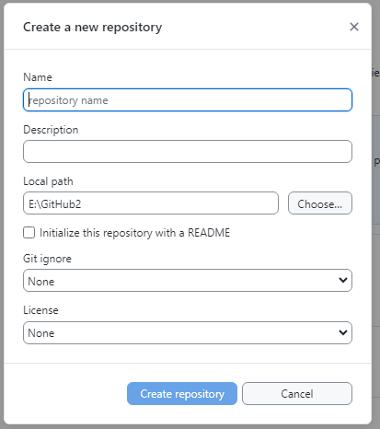
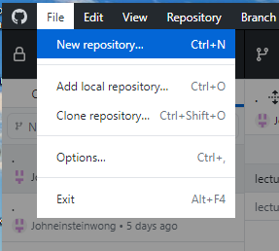
Creating a new local repository on an existing account
To create a new repository on existing account with other repos:
Click File → New repository
Fill in the details
Click Create repository
37

Slide 38
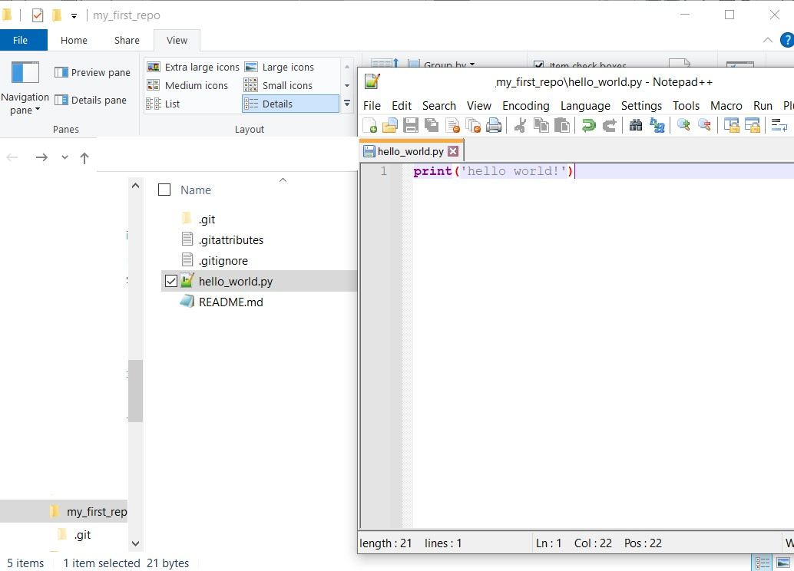
GitHub Desktop: Create and edit new file
Open your favorite text editor
Inside your repo, create a file and rename it as “hello_world.py”
Type ”print(‘hello world!’)” inside the file and save it
38

Slide 39
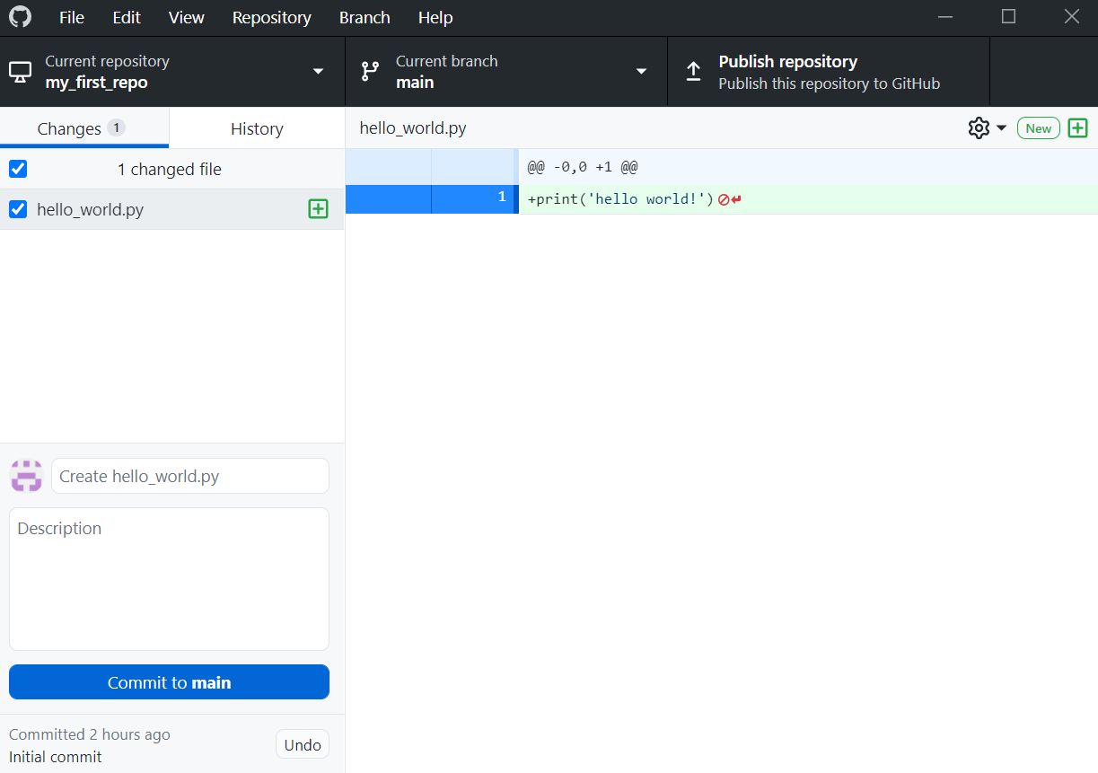
GitHub Desktop: Modified and commit states
You will see your “hello_world.py” under the “Changes” section
“hello_world.py” is now in “modified” states (remember the three states)
39

Slide 40
GitHub Desktop
Write a summary and description of the changes you made (optional)
Click “Commit to main”
Note:
The default summary “Create hello_world.py” has been generated for you by GitHub Desktop
At the back, GitHub Desktop will run the commands “git add” and then “git commit”
Your file will be “staged” and then be “committed”
40

Slide 41
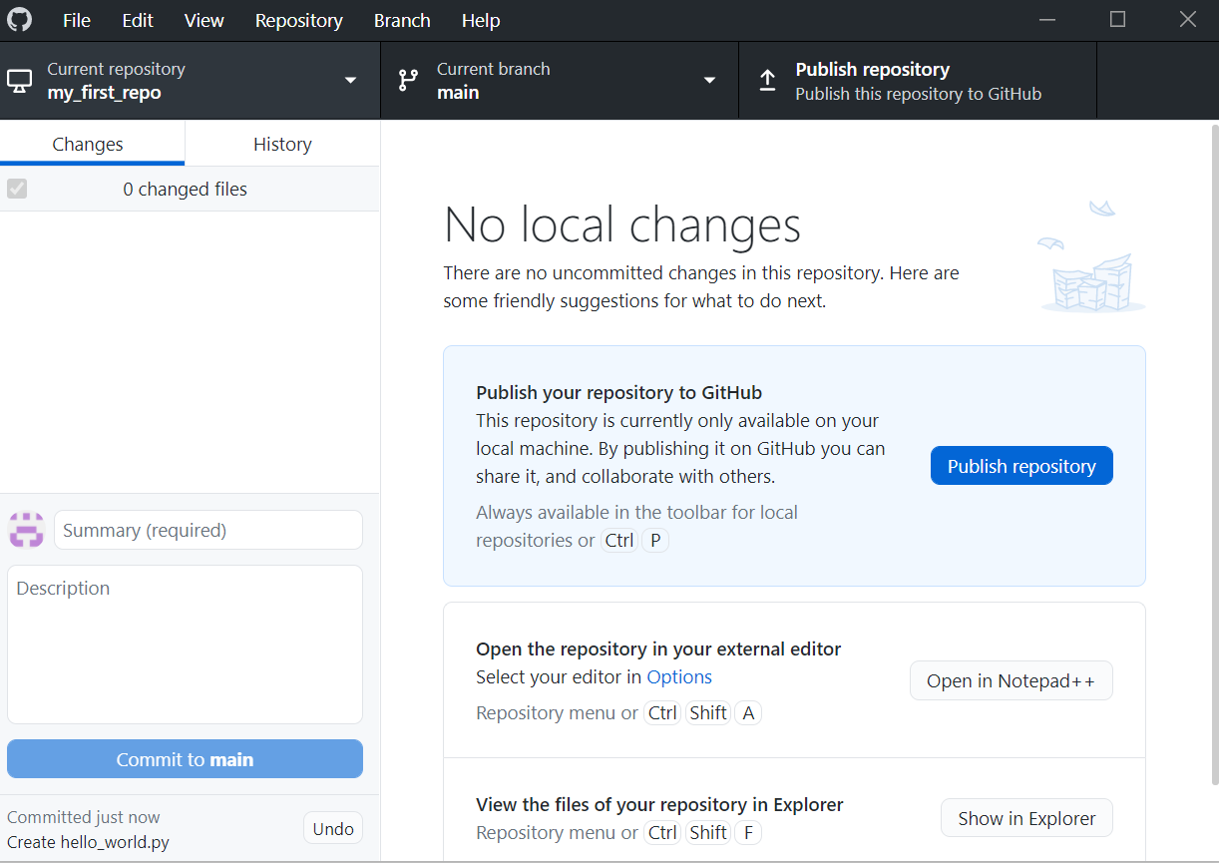
GitHub Desktop: Publish repo
Click “Publish repository” to upload your repo to GitHub and save it online
41

Slide 42
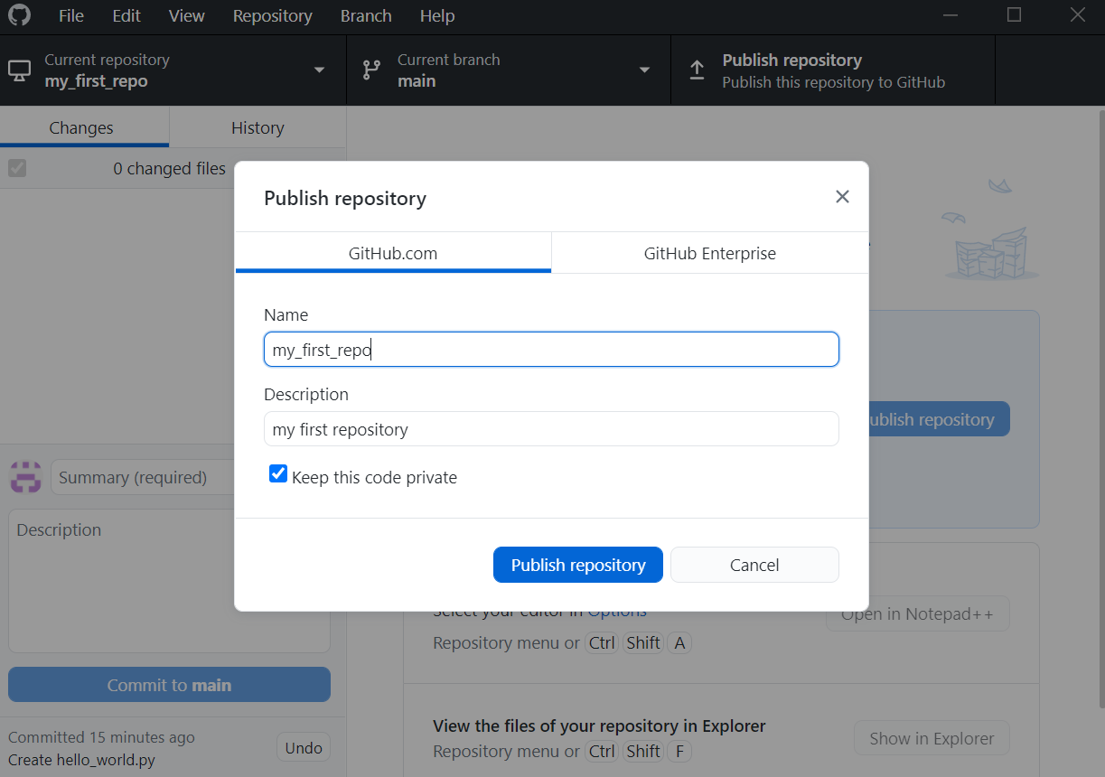
GitHub Desktop
Check the box for “keep this code private” (optional)
Click “Publish repository”
42

Slide 43
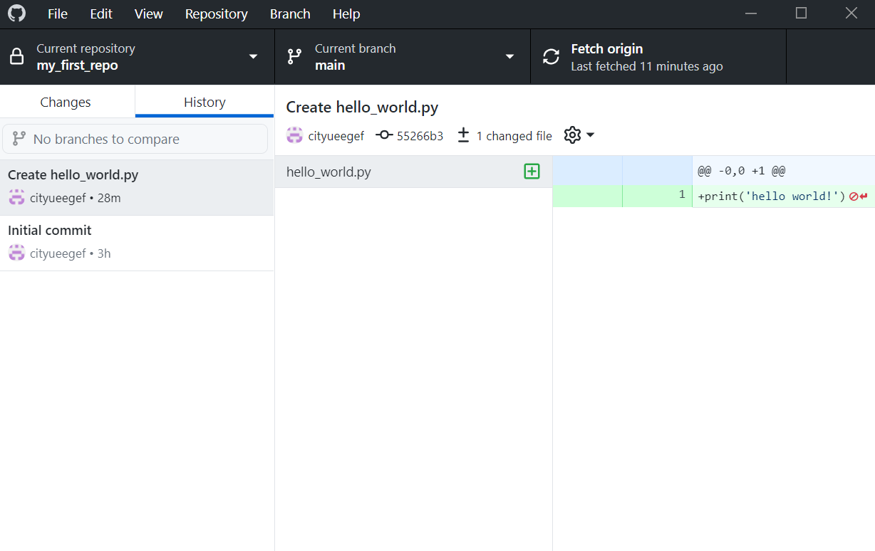
GitHub Desktop
Alternatively, you can see your commit history under the “History” section inside GitHub Desktop
43

Slide 44
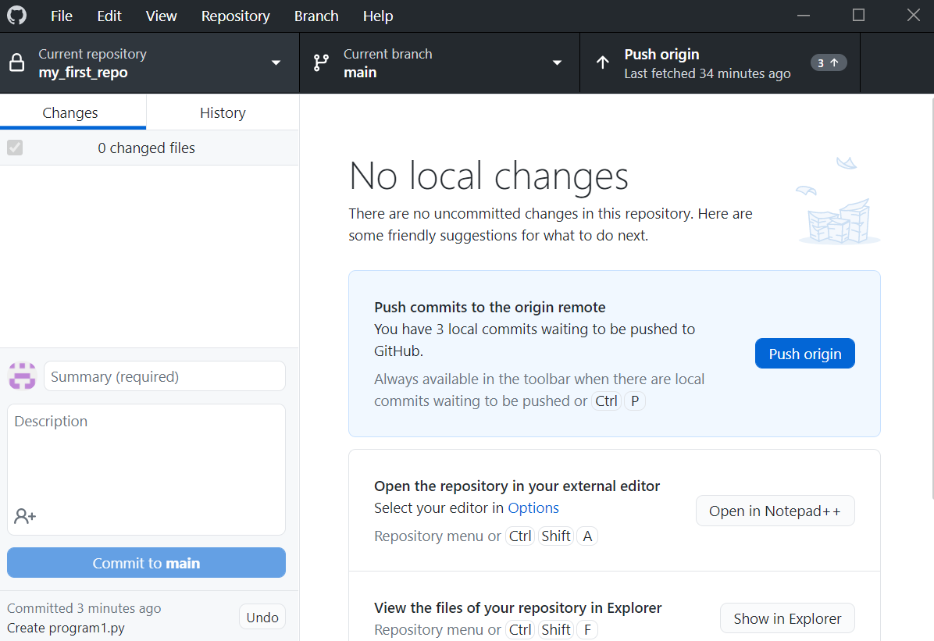
GitHub Desktop: Push
After each commit, you may click “Push origin” to sync with your GitHub repo online
44

Slide 45
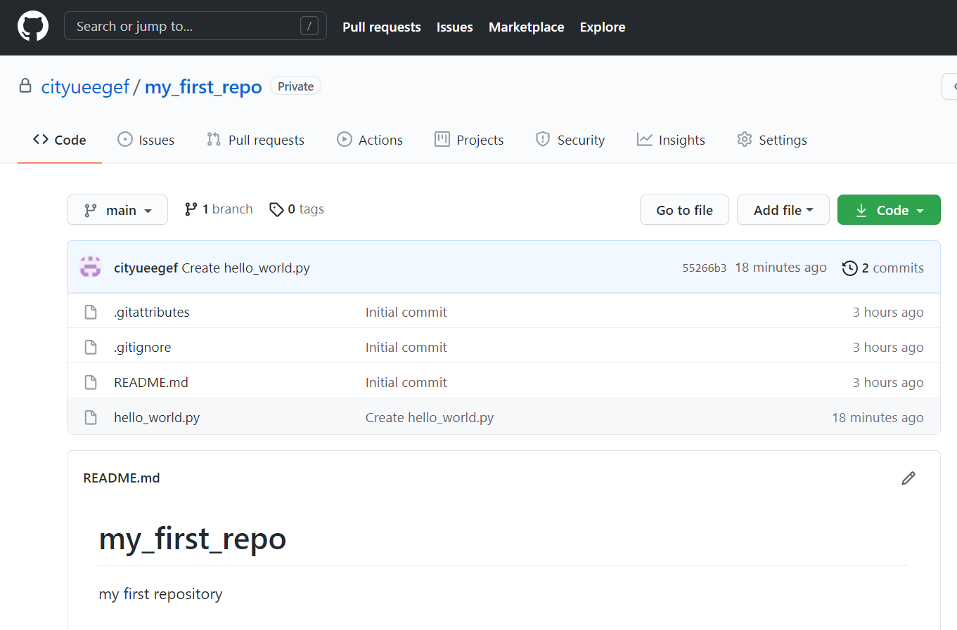
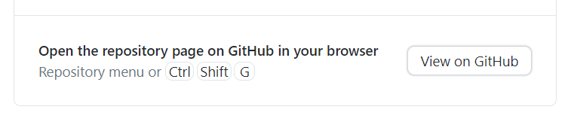
New repo push to github
1. Inside GitHub Desktop, click “View on GitHub”
2. It will open a browser and bring you to your GitHub page containing your repo
3. You may review your commit history by clicking “commits”
45

Slide 46
New repo push to github
1. Inside GitHub Desktop, click “View on GitHub”
2. It will open a browser and bring you to your GitHub page containing your repo
3. You may review your commit history by clicking “commits”
46

Slide 47
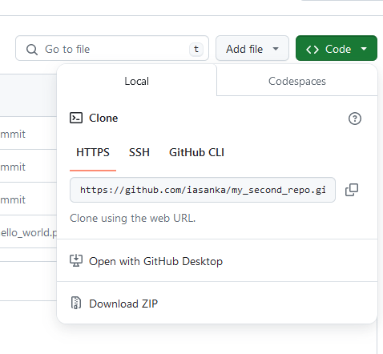
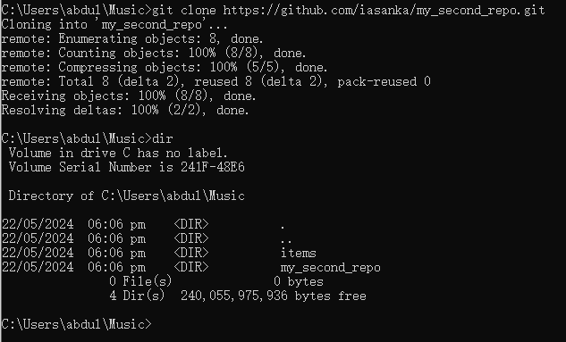
Cloning and downloading a repo
Cloning copies the entire repository as it is.
You can also download the repo as a zip file
Click to the Code section and Download ZIP
To clone a repo, run this command from a terminal/command line
>> git clone <url of the repo> e.g.,
>> git clone https://github.com/iasanka/my_second_repo.git
47

Slide 48
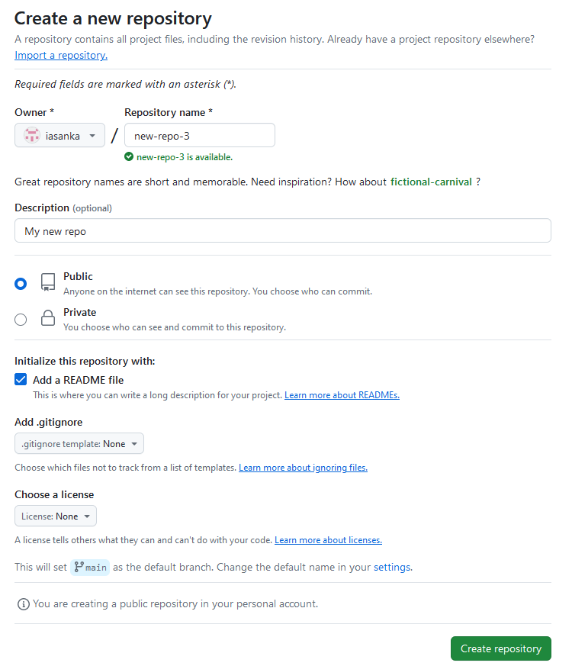
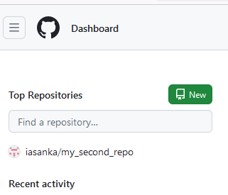
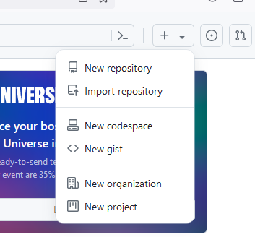
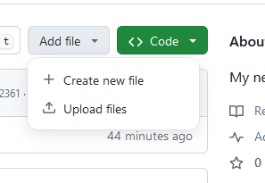
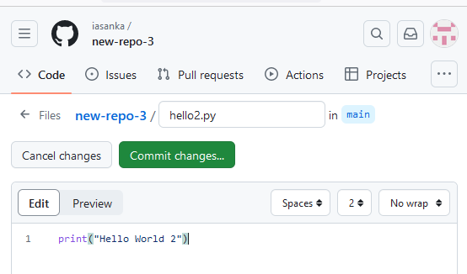
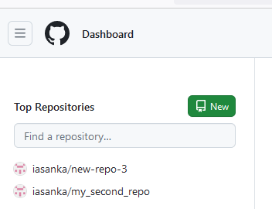
Creating a new repo and files on GitHub
Click New
Fill in the info and click
and click Create repository
Open your new repo
Click Add file and create a new hello2.py
Edit the file and commit changes.
Write the description and commit changes to the main.
1
2
4
5
3
48

Slide 49
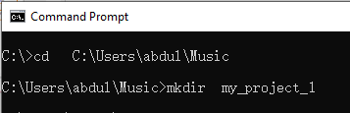
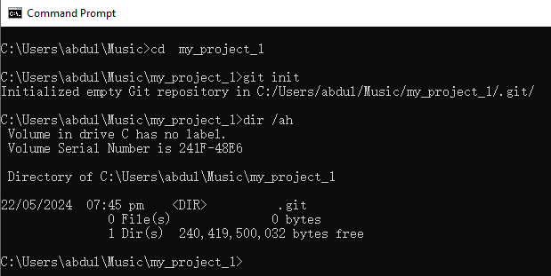
GitHub Using Git Client
Install the Git client
http://git-scm.com/downloads
Create a new repo in a desired location
>> cd C:\Users\abdul\Music
>> mkdir my_project_1
Goto the repo
>> cd my_project_1
Initialize the repo
>> git init
>> dir /ah (ls -a in Linux)
(* .git directory to store all the tracing info)
49

Slide 50
Git configuration from client
Git configuration connects the client with your github account
Use file Explorer and add a new file to my_third_repo
>> git config --global user.name “abdulsanka“
>> git config --global user.email “iasanka2-c@my.cityu.edu.hk”
50

Slide 51
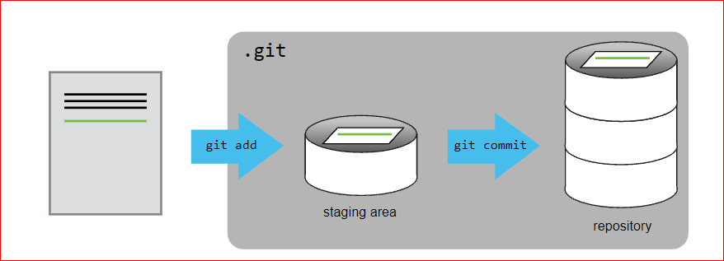
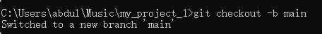
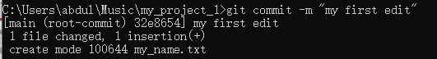
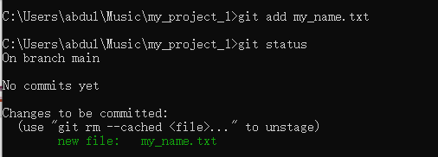
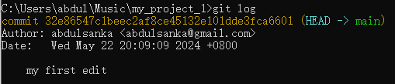
Adding file to git
Create a file my_name .txt
Create the main github branch
>> git checkout -b main
Stage my_name.txt
>> git add my_name.txt
>> git status
Commit the file to the local repo
>> git commit –m “my first edit”
Log the activities
>> git log
51

Slide 52
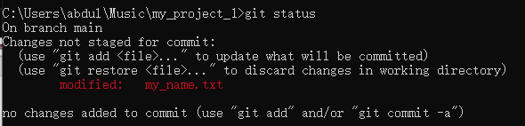
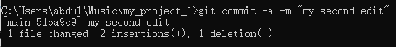
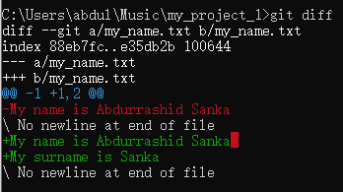
Adding file to git, cont..
Change the content of my_name .txt
Check the status
>> git status
Check the difference between the two files
>> git diff
Commit the file to the local repo
>> git commit -a –m “my second edit”
52

Slide 53
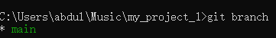
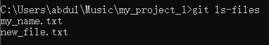
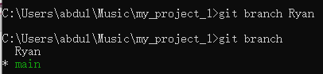
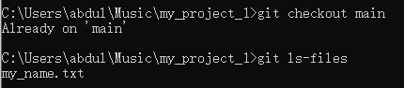
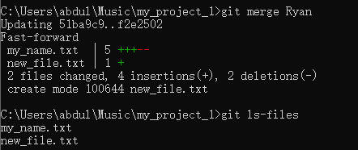
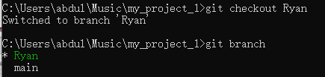
Branching and Merging
Check the available branches
>> git branch
Create a new branch
>> git branch Ryan
>> git branch
Switch to a branch
>> git checkout Ryan
Modify the file and stage
>> git add my_name.txt
>> git status
Commit the file to the local repo
>> git commit -a –m “edits in Ryan”
Check the files in Ryan branch
>> git ls-files
Switch to the main branch and check the files in it
>> git checkout main
>> git ls-files
Merge the two branches
>> git merge Ryan
Check the files again
53

Slide 54
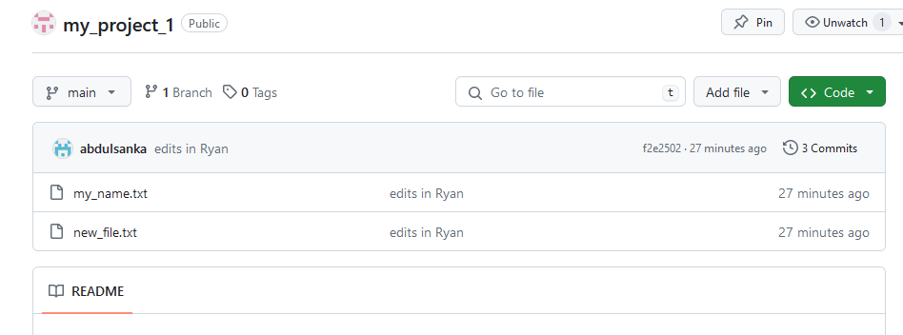



Uploading to the GitHub
To upload your local repository to the remote repo (GitHub), you are said to push the repo
On GitHub, create a new repo my_project_1
Add the remote repo to the git
>> git remote add origin https://github.com/iasanka/my_project_1
Push the local repo to the GitHub repo
>> git push -u origin main
54

Slide 55

Git Cheat Sheet 1
55

Slide 56

Git Cheat Sheet 2
56

Slide 57

Git Cheat Sheet 3
57

Slide 58

Git Cheat Sheet 4
58

Slide 59
Resources
Git documentation: https://git-scm.com/book/en/v2/Getting-Started-About-Version-Control
ProGit ebook: https://git-scm.com/book/en/v2
GitHub Docs – Quickstart: https://docs.github.com/en/github/getting-started-with-github/quickstart
GitHub Docs – Getting started with GitHub Desktop https://docs.github.com/en/desktop/installing-and-configuring-github-desktop/overview/getting-started-with-github-desktop
59

Slide 60



